Slide 1



Quality Improvement (QI) Process
Quality Improvement Secretariat
Health Economics Unit, HSD, MoHFW

Slide 2
QI process
There are 10 steps in Quality Improvement (QIS) process to ensure quality healthcare services in a medical college hospital, DH and UHC.
Step 1: Advocacy for Leaders and Managers
Step 2: 5S
Step 3: Infection Prevention and Control (IPC)
Step 4: Patient Safety Program
Step 5: Plan-Do-Check-Act (PDCA)

Slide 3
QI Process (cont)
Step-6 : Maternal and Peri-natal Death Surveillance and Response (MPDSR)
Step 7: Waste Management Program
Step 8: Clinical Audit
Step 9: Death Audit
Step 10: Anti-Microbial Stewardship (AMS) Program

Slide 4
QI Process (cont)
Step 1: Advocacy for Leaders and Managers
  Quality and Healthcare Quality
  Facility Level QIC Structures and TOR
  WIT structure and TOR
  QI methods and QI strategic plan of MOHFW
  QI Implementation Roadmap

Slide 5
QI Process (cont)
Step 1: Advocacy for Leaders and Managers
Quality and Healthcare Quality
  Quality and healthcare quality is “the extent to which health care services provided to individuals and patient populations improve desired health outcomes. In order to achieve this, health care must be safe, effective, timely, efficient, equitable and people-centred.”

Slide 6
QI Process (cont)
Step 1: Advocacy for Leaders and Managers
Quality and Healthcare Quality
  Safe. Delivering health care that minimizes risks and harm to service users, including avoiding preventable injuries and reducing medical errors.
  Effective. Providing services based on scientific knowledge and evidence-based guidelines.
  Timely. Reducing delays in providing and receiving health care.
  Efficient. Delivering health care in a manner that maximizes resource use and avoids waste.
  Equitable. Delivering health care that does not differ in quality according to personal characteristics such as gender, race, ethnicity, geographical location or socioeconomic status.
  People-centred. Providing care that takes into account the preferences and aspirations of individual service users and the culture of their community

Slide 7
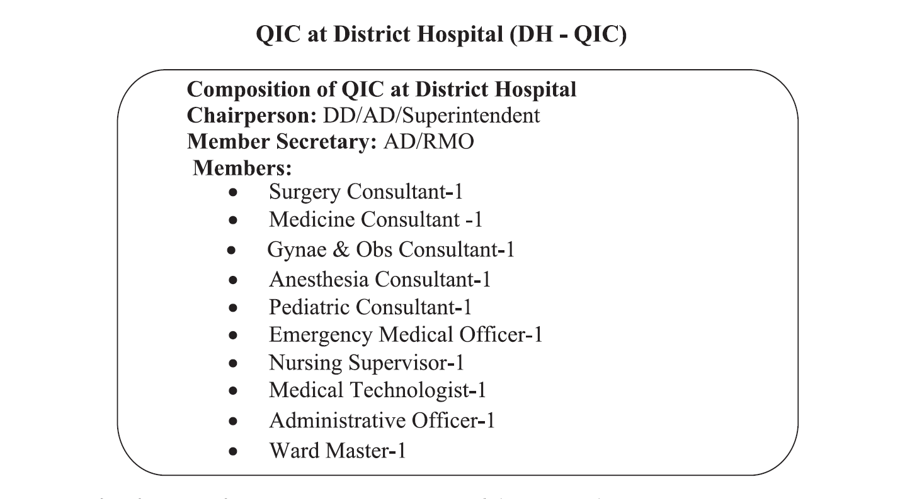
QI Process (cont)
Step 1: Advocacy for leaders and managers
Facility Level QIC Structures and TOR
  According to Strategic Planning on Quality of care for Heath Services Delivery in Bangladesh, the composition of District Hospital QIC will be like

Slide 8
QI Process (cont)
Step 1: Advocacy for leaders and managers
  Terms of references of DH QIC
  Ensure monthly QIC meeting and reporting to divisional QIC with the meeting resolution and keeping a copy to QIS
  Ensure implementation of QI strategies and guideline to attain quality of care.
  Monitoring and mentoring of QI teams at DH
  Periodic review of the process of the QI activities at DH
  Capacity building the staff to ensure quality healthcare services
  Set targets, roadmaps and goals for best practice
  Yearly organize award giving ceremony at DH

Slide 9
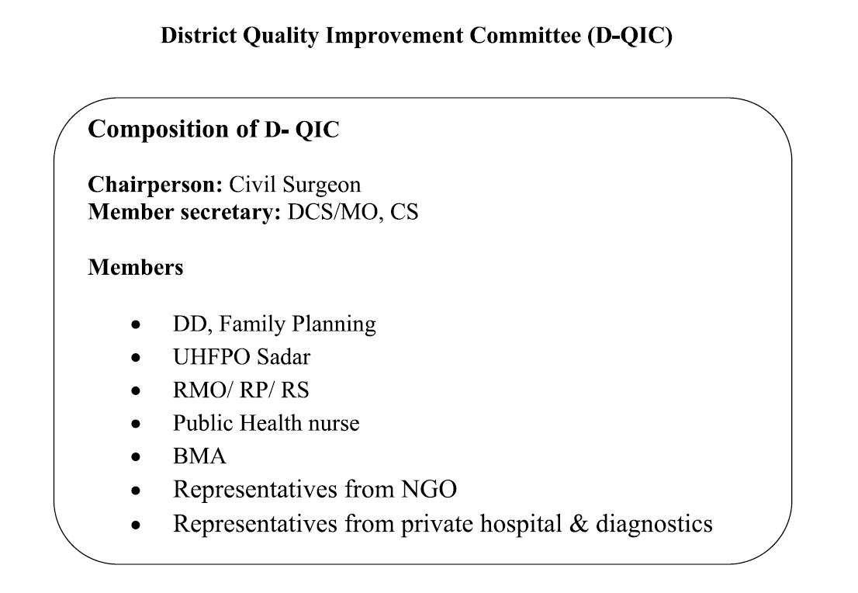
QI Process (cont)
Step 1: Advocacy for leaders and managers
Organizational Level QIC Structures
  According to Strategic Planning on Quality of care for Heath Services Delivery in Bangladesh, the composition of District-QIC will be like

Slide 10
QI Process (cont)
Step 1: Advocacy for leaders and managers
  Terms of references of D-QIC
  Ensure monthly QIC meeting and reporting to divisional QIC with the meeting resolution and keeping a copy to QIS
  Ensure implementation of QI strategies and guideline to attain quality of care.
  Ensure monthly QI review meeting with the presence of Upazilla level facilities
  Periodic review of the QI process at Upazilla level facilities.
  Set targets, roadmaps and goals for best practice at Upazilla level facilities.
  Ensure yearly award giving ceremony at the Upazilla level facilities.

Slide 11
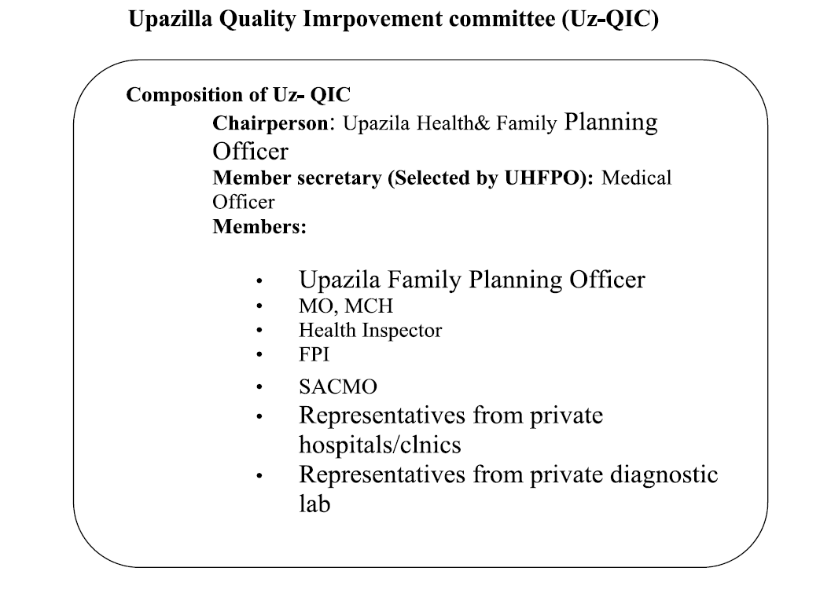
QI Process (cont)
Step 1: Advocacy for leaders and managers
Organizational Level QIC Structures
  Upazilla-QIC will be like

Slide 12
QI Process (cont)
Step 1: Advocacy for leaders and managers
  Terms of references of Uz-QIC
  Ensure monthly QIC meeting and reporting to District-QIC with the meeting resolution and keeping a copy to QIS
  Ensure implementation of QI strategies and guideline to attain quality of care.
  Monthly supervisory visit to Upazilla and below level facilities
  Periodic review of the QI process at Upazilla level facilities.
  Set targets, roadmaps and goals for best practice at Upazilla level facilities.
  Ensure yearly award giving ceremony at the Upazilla level facilities.

Slide 13
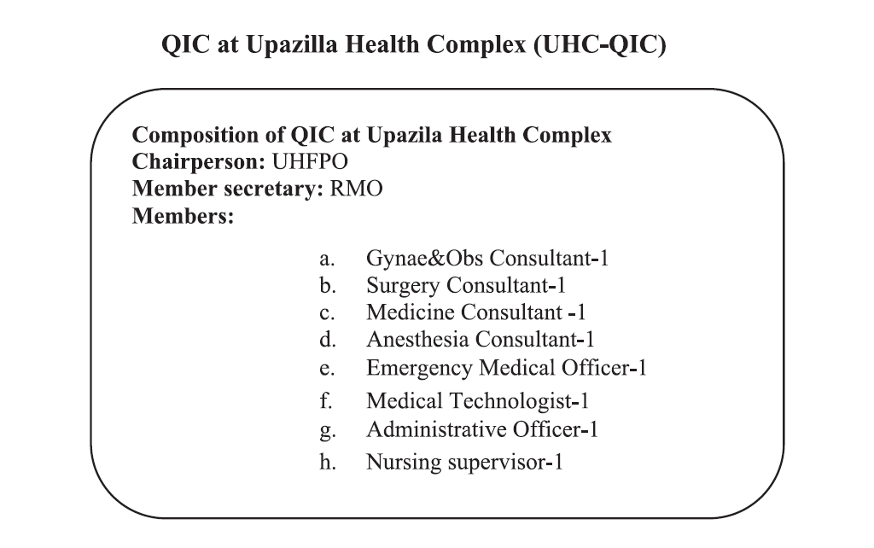

Composition of QIC for Upazila Health Complex (UHC-QIC)

Slide 14
Terms of references of UHC-QIC
  Ensure monthly QIC meeting and reporting to District-QIC with the meeting resolution and keeping a copy to QIS
  Ensure implementation of QI strategies and guideline to attain quality of care.
  Monitoring and mentoring of QI teams at UHC
  Periodic review of the process of the QI activities at UHC
  Capacity building the staff to ensure quality healthcare services
  Set targets, roadmaps and goals for best practice at UHC
  Yearly organize award giving ceremony at UHC
  Can co-opt any members as per requirement.

Slide 15
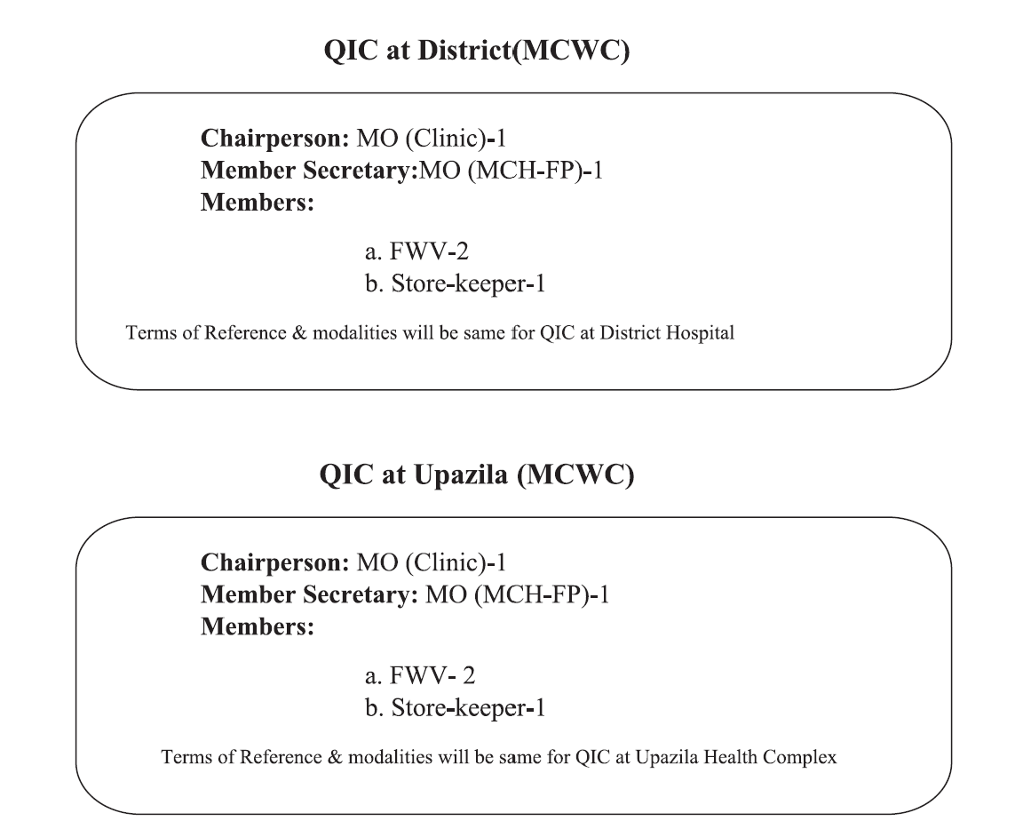
Composition of QIC for Maternal and Child Welfare Centre (MCWC)

Slide 16
Composition of WIT Monitoring Team
There are 2-3 members from QIC and or Nursing Superintendent / Supervisor of the respected WIT area.

Slide 17
Composition of WIT
Position | Person
Facilitator | MO and above
Team leader | Nursing In charge / SSN / Any one suitable for the section
Member secretary | SSN (Sub- In Charge) / Any one suitable for the section
Member | SSN/ MLSS / Aya / Ward boy
Member | SSN/ MLSS / Aya / Ward boy
Member | Cleaner

Slide 18
Roles and responsibilities of WIT:
5S implementation
Holding regular meetings (Weekly)
Preparing action plan (Monthly)
Taking pictures to demonstrate changes (before and after) in their respective sections

Slide 19
Roles and responsibilities of WIT Conti…
Identifying problems in their own sections and present the future plan in QIC meeting through QI focal person of the facility
Trying to solve the problems what they can solve with their existing resources
Seeking support from QIC for the problems they cannot solve
Finding out innovative ways to work

Slide 20
QI Process (cont)
Step 1: Advocacy for leaders and managers
QI Methods and QI Strategic Plan of MOHFW
5S-CQI-TQM method and national QI strategic plan for ensuring quality healthcare services
“Strategic Planning on Quality of care for Heath Services Delivery in Bangladesh”

Slide 21
QI Process (cont)
Step 1: Advocacy for leaders and managers
QI Implementation Road Map
Every Health Facility should have a step wise implementation road map and action plan to achieve the Total Quality Management (TQM)

Slide 22
QI Process (cont)
Step 2: 5S
5S is a philosophy and a way of organizing and managing the workspace and workflow with the intent to improve efficiency by eliminating waste, improving flow and reducing process unreasonableness.
5S consist of Sort, Set, Shine, Standardize and Sustain.
QIS already developed the ‘TQM Module’ for ensuring quality healthcare services, especially 5S.

Slide 23
QI Process (cont)
Step 3: Infection Prevention and Control (IPC)
The specific objectives of IPC are to provide directions and information related to
• Formation of IPC committee and teams with TOR
• Standard and transmission based precautions
• Cleaning, disinfecting, sterilization and reprocessing of reusable equipment
• IPC in special situations (COVID-19)
Monitoring IPC program and tools
“National Hospital Infection Prevention and Control Manual”

Slide 24
QI Process (cont)
Step 4: Patient safety program
Patient safety is the absence of preventable harm to a patient during the process of health care and reduction of risk of unnecessary harm associated with health care to an acceptable minimum.
Domains of patient safety (HCAI, Medication safety, Patient ID & procedure matching, Clinical handover, Blood and Blood products, Pressure injuries, Clinical deterioration, Fall associated harm)
Safe Surgery Checklist
Patients Safety Tools
Monitoring and reporting tools
‘National Patient Safety Strategic Planning in Bangladesh’
Notes:
Patient Safety Tools Name:

Slide 25
QI Process (cont)
Step 5: Plan-Do-Check-Act (PDCA)
PDCA is the “golden cycle for improvement”. It is a methodical approach for problem solving and continuous improvement.
Plan is to establish objectives and process or countermeasures with expected outcome based on the past performances or future forecasting of work.
Do is to implement the processes or countermeasures planed.
Check is to measure the effectiveness or achievement of processes or countermeasures planed between the actual results and expected results to ascertain any differences.
Act is to analyse the differences to identify the causes of “Gap”, and take necessary action to improve changes
PDCA review and feedback
“PDCA Manual for Quality Improvement”

Slide 26
QI Process (cont)
Step-6 : Maternal and Peri-natal Death Surveillance and Response (MPDSR)
Main objectives of facility based MPDSR is to determine medical causes of deaths in the facility and explore the system bottlenecks and corrective actions to avert such deaths in future.
Facility based sub-committee formation.
Death notification.
Facility death review (FDR)
Facility level action plan development
Regular monitoring and supervision
“National Guideline on MPDSR, ToT Manual on MPDSR and Pocket book for MPDSR”
Notes:
Maternal death: Death of a woman during pregnancy, delivery or within 42 days of the termination of pregnancy due to complications related to pregnancy, delivery or post-partum period
Neonatal death: Deaths occurring during the first four weeks (28 days) after birth
Stillbirth: A baby born with no signs of life at or after 28 weeks gestation (did not take any breath/ did not have any movement) is considered as stillbirth.
Perinatal death: Includes both deaths in the first week of life and fetal deaths [stillbirths + neonatal deaths within 7 days of birth].

Slide 27
QI Process (cont)
Step 7: Waste Management Program
Steps of hospital waste management are:
Waste Generation
Segregation/ Separation with color coded bins
Waste Collection
Transportation
Storage
Treatment
Final disposal
Monitoring and supervision

Slide 28
QI Process (cont)
Step 8: Clinical Audit
Clinical audit is a process used for measuring quality in healthcare and is an integral part of clinical governance at a local level
Clinical audit is a quality improvement process that seeks to improve patient care and outcomes through systematic review of care against explicit criteria and the implementation of change
Clinical audit is a key and essential component of clinical governance.
Record keeping, monitoring and reporting

Slide 29
QI Process (cont)
Step 9: Death Audit
Death audit is important because it gives an understanding to what happens and why.
This helps to go beyond rates and ratios to determine the inciting factors and to take measures how deaths could have been avoided
Record keeping, monitoring and reporting

Slide 30
QI Process (cont)
Step 10: Anti-Microbial Stewardship (AMS) program
AMS is coordinated program that promotes appropriate use of antimicrobials, improves patient’s outcomes, reduces microbial resistance and decrease the spread of infections caused by multidrug-resistant organism in the facility level
Eight clinical standards of QI frameworks
Record keeping, monitoring and reporting
“National Antimicrobial Stewardship Quality Improvement Framework”

Slide 31

17-Feb-21

